Slide 1

SE/SC Artistic Grades
20th/21st/22nd March 2026
CNGA

Slide 2

Welcome to the Womens Artistic South East and South Central Grades for 2026
This years area grades are being held in City of Newport Gymnastics Academy
Contained within this document are the running orders, the gymnast groups and competition officials.
Event Officials
Competition Managers – Leah Whiffin/Sam Elliott
Safeguarding and Wellbeing Officer – CNGA
Link for tickets: https://welshgymnastics.sport80.com/public/wizard/e/580

Slide 3

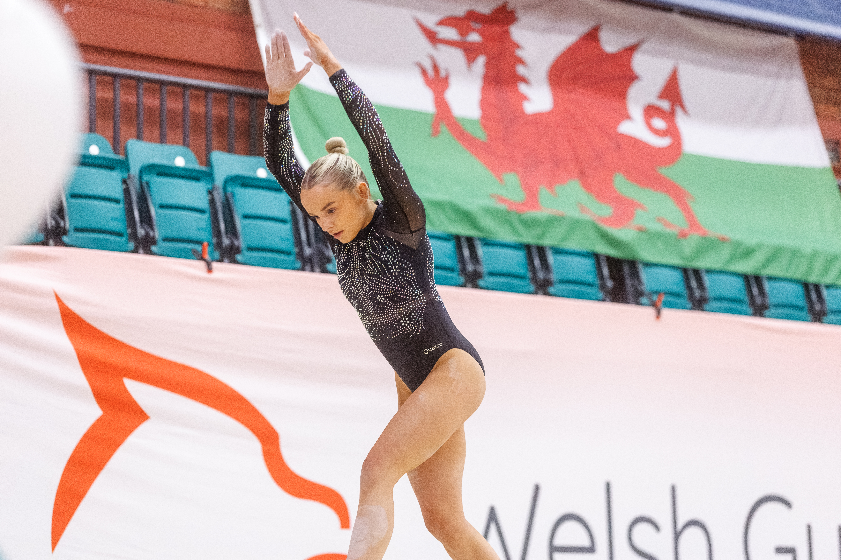
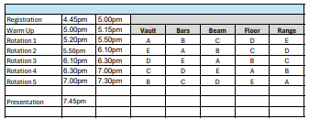
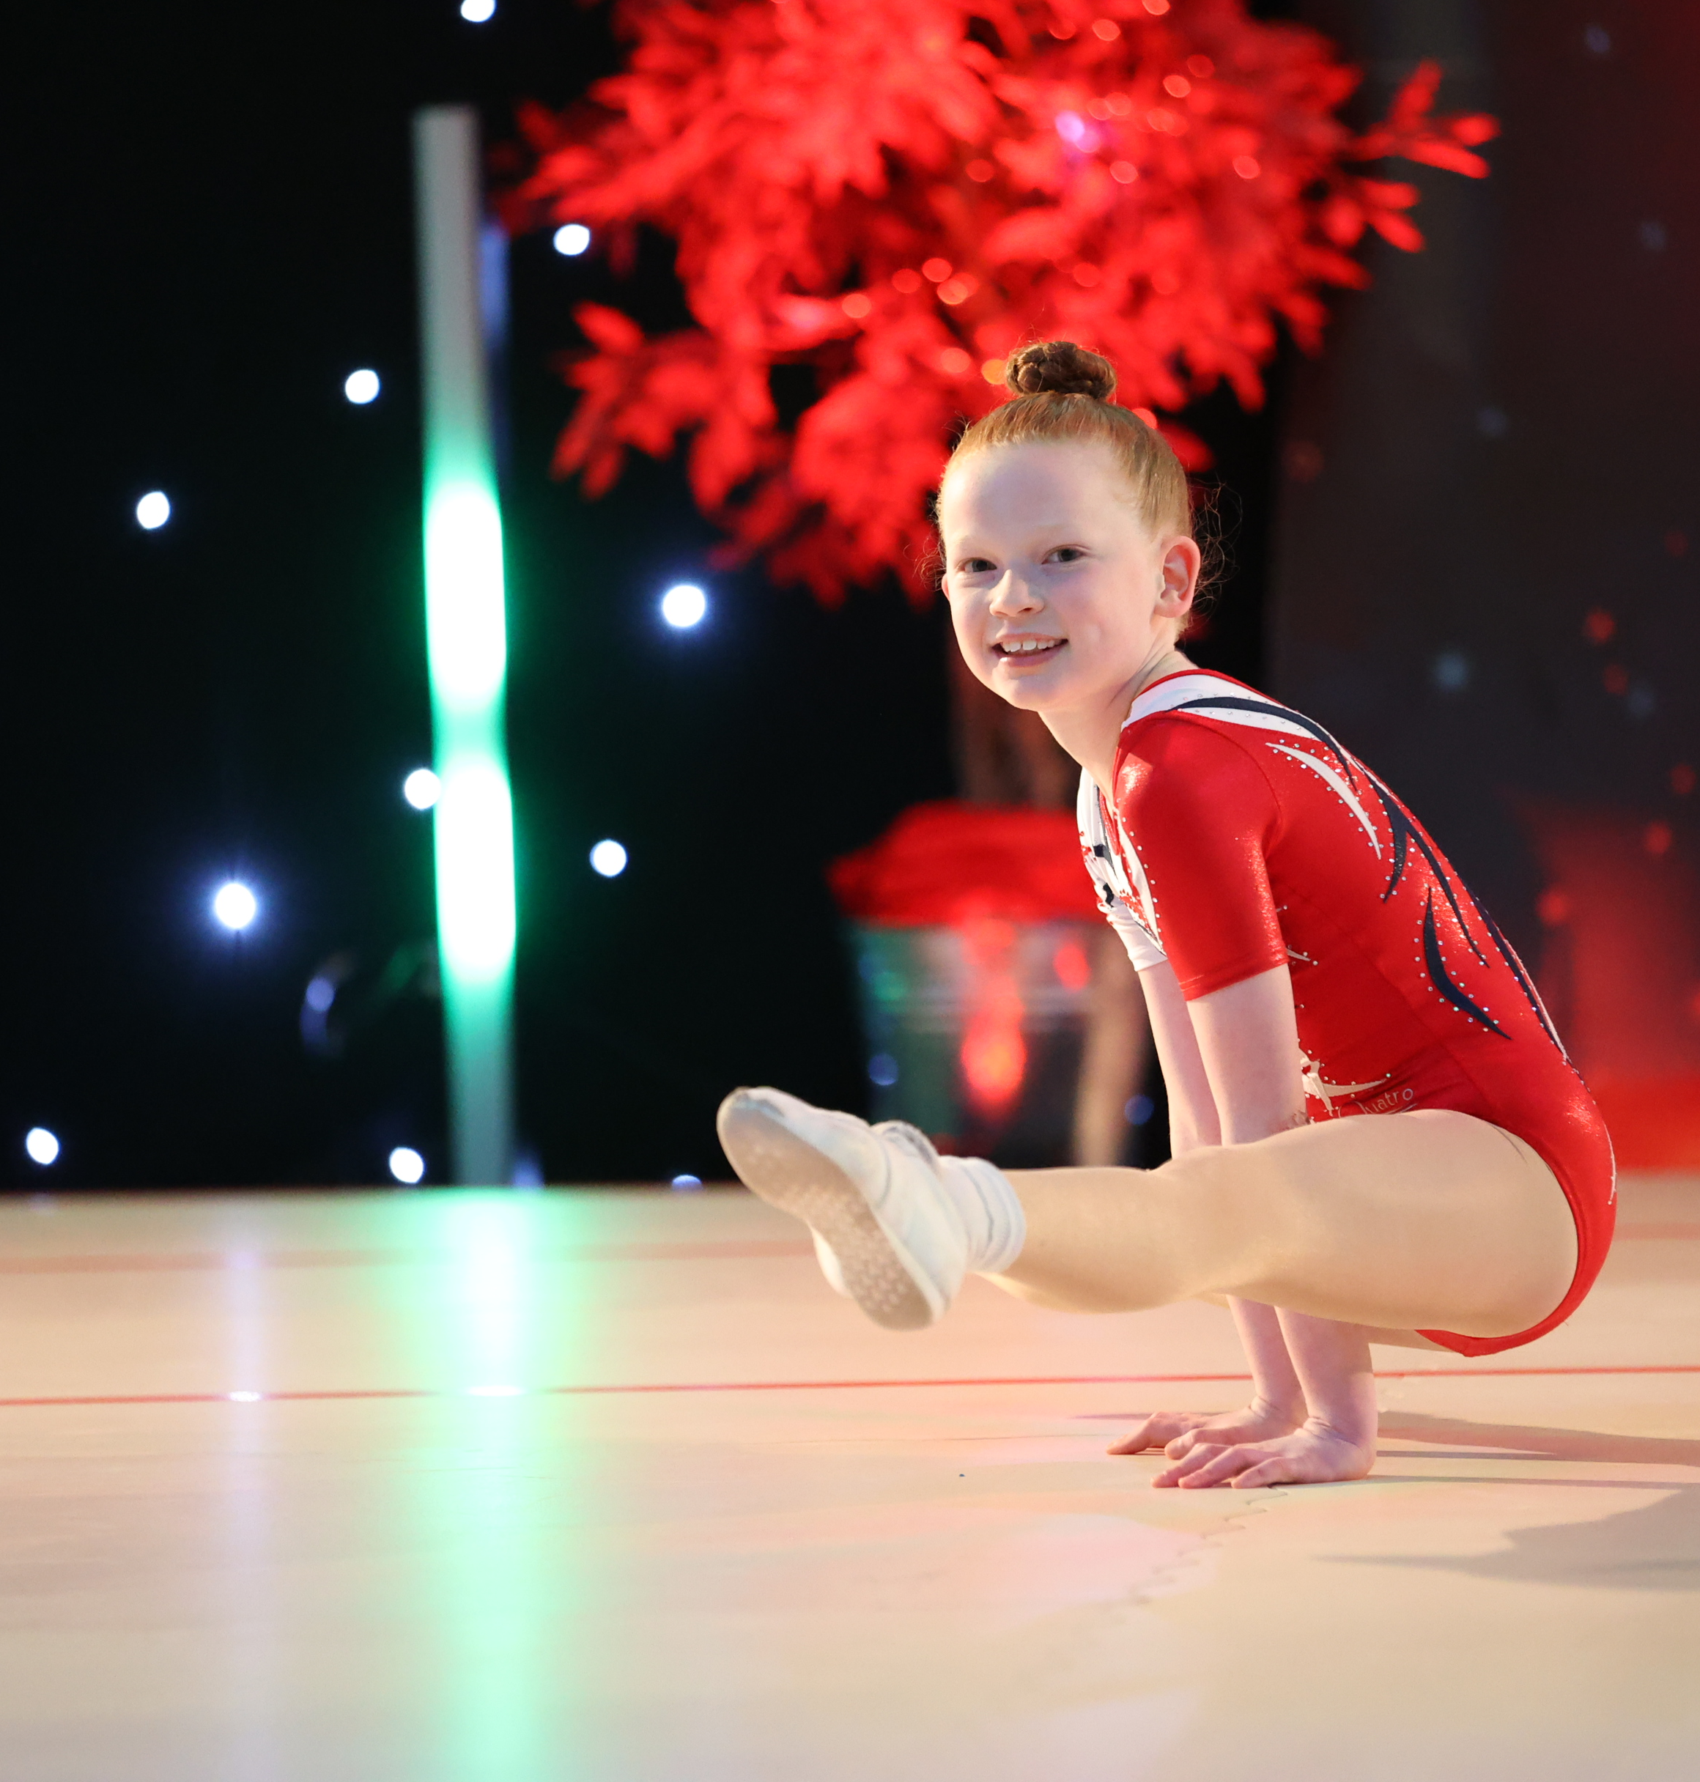

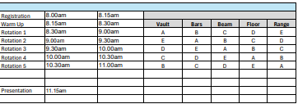
FRIDAY
SATURDAY R1

Slide 4
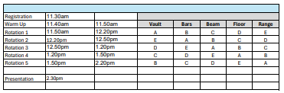
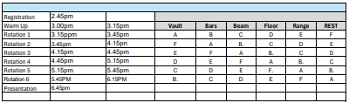
SATURDAY R2
SATURDAY R3

Slide 5
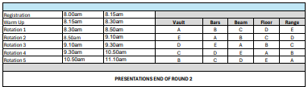

SUNDAY R1
SUNDAY R2

Slide 6
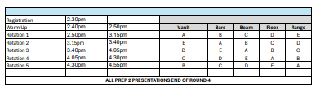
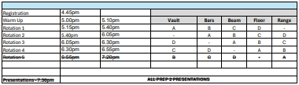
SUNDAY R3
SUNDAY R4

Slide 7
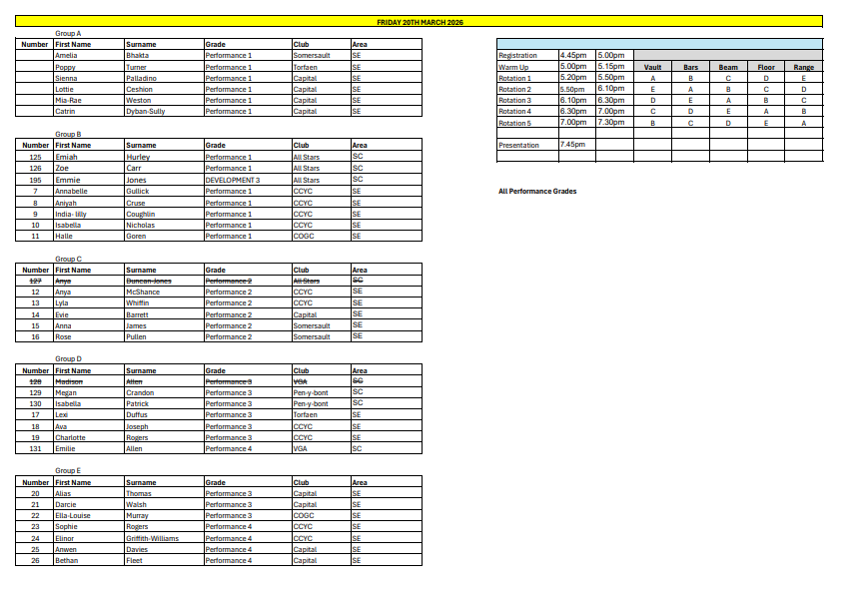

Slide 8
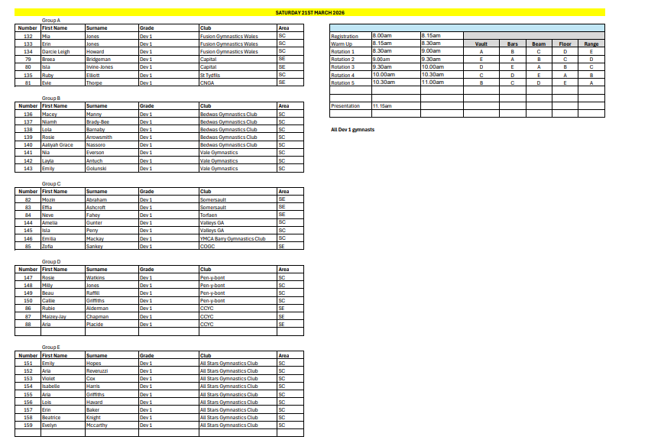

Slide 9
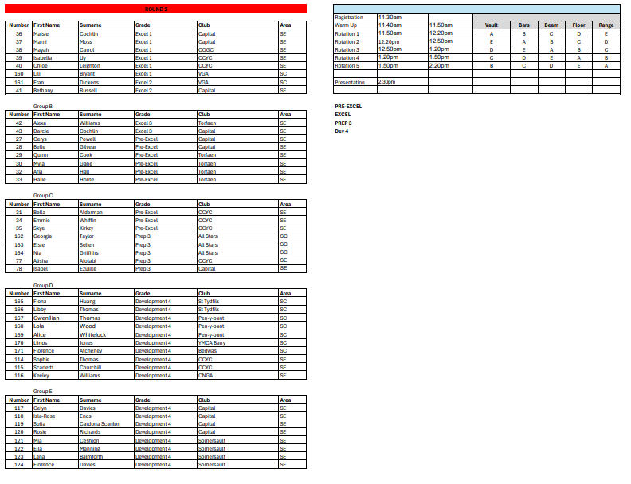

Slide 10
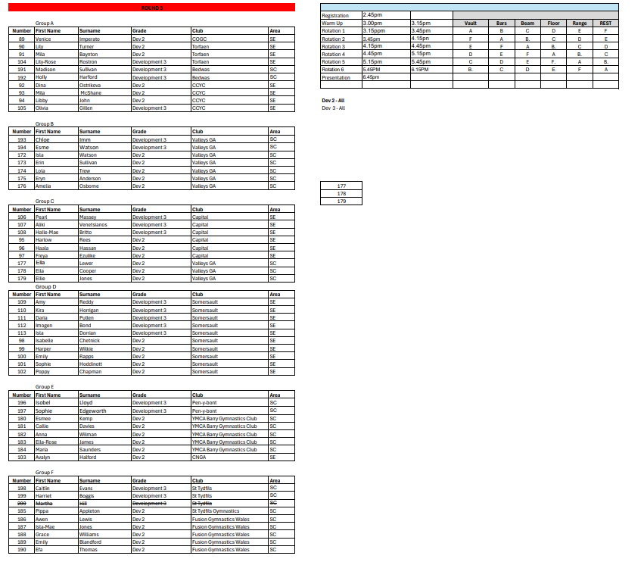

Slide 11
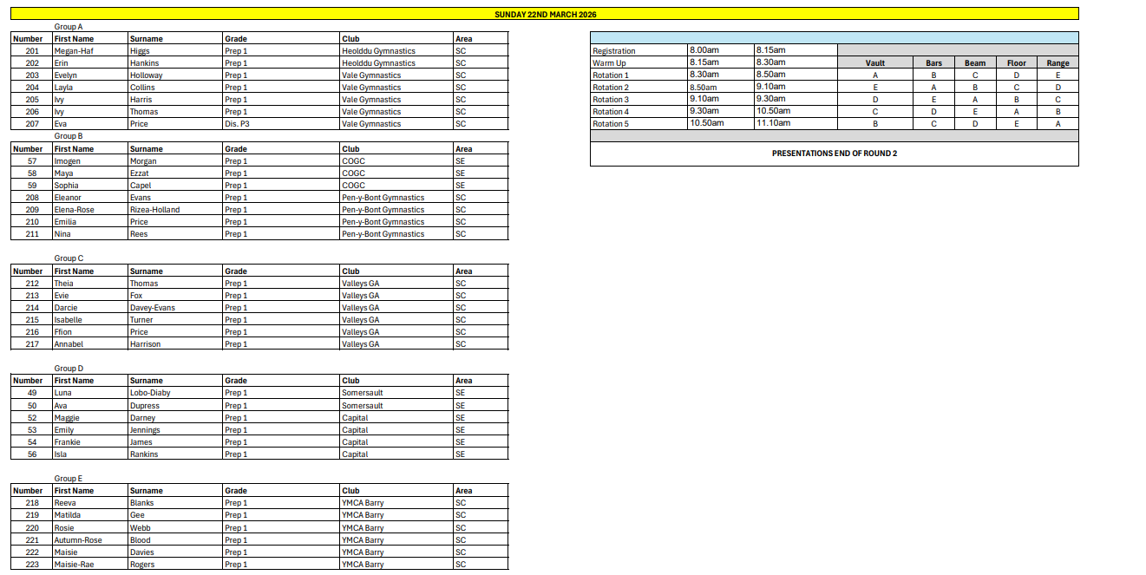

Slide 12
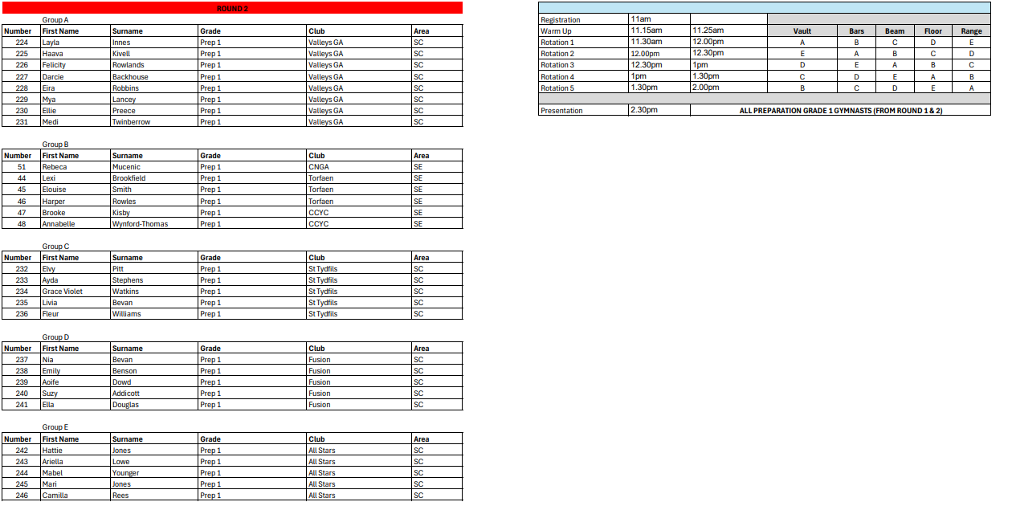

Slide 13
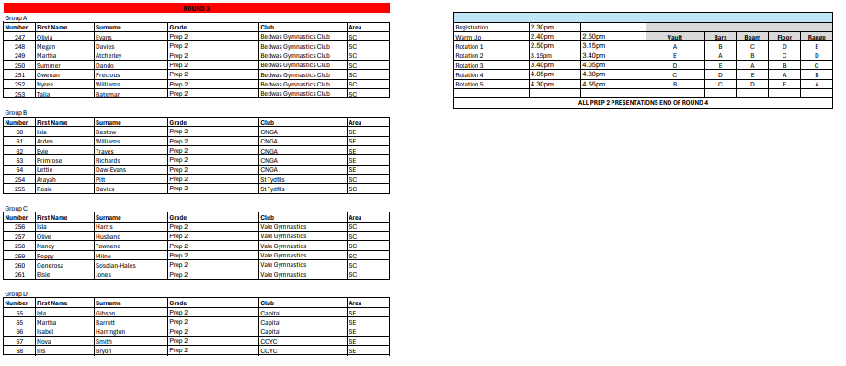
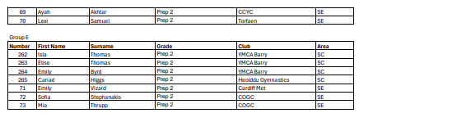

Slide 14
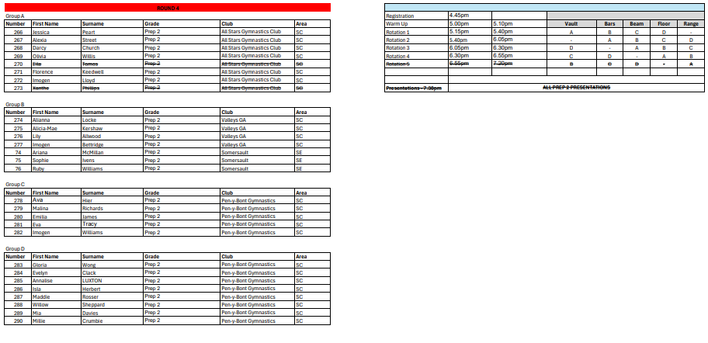

Slide 15

Some dates for your diary:
ABC 1 Delyn – 13th/14th June
Floor & Vault (CWG themed) – 18th/19th July
ABC 2 Sport Wales (CWG themed) – 25th/26th July
Commonwealth Games Gymnastics start – 24th July
GOOD LUCK TO ALL GYMNASTS

Slide 16


